Slide 1
Data Analysis Project of the WHO’s Global Health Expenditure Database 2000-2020 (Dec. 2022 version)
Team members: Diana, Jonathan, Emilia, Rebekah

Slide 2
How often do we consider our healthcare
day to day?

Slide 3
The U.S. alone increased spending by 9.7 percent in 2020 to $4,124.0 billion or $12,530 per capita. In comparison, spending grew 4.3 percent in 2019. In 2020, the U.S. spent 19.7% of its GDP on health consumption (up from 17.6% in 2019!)

Slide 4
This leads you to wonder what this may look like on a global scale?
How does contraception play a factor?

Slide 5
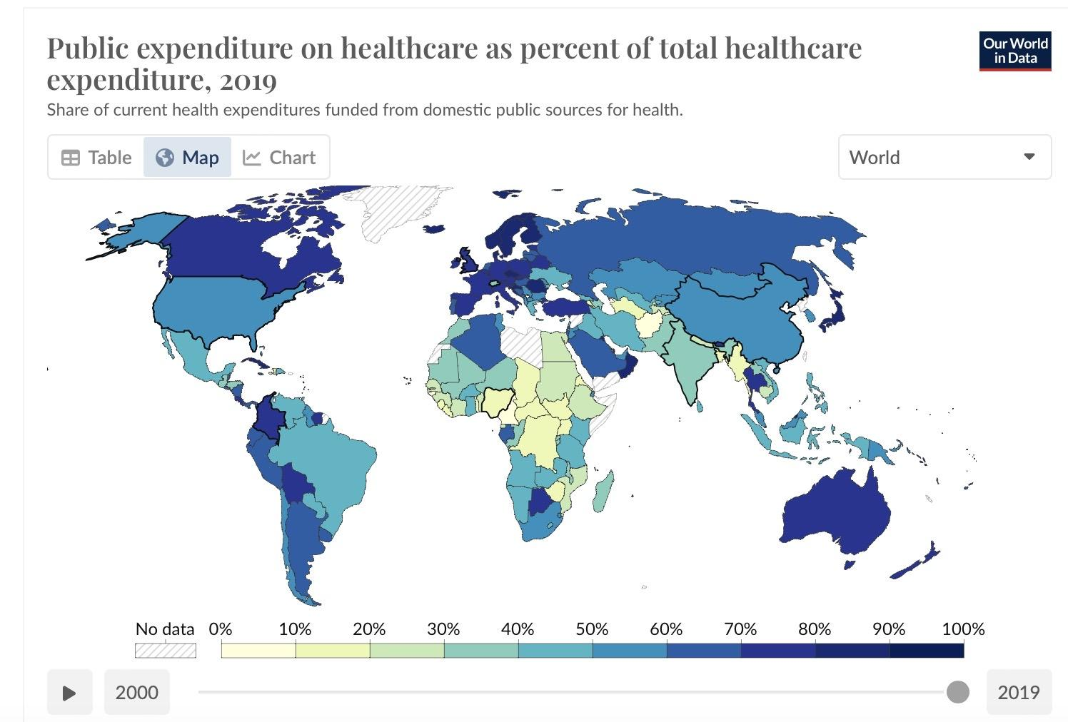

Slide 6
WHO - Stands for world health organization in our dataset
GDP - standard measure of gross domestic Product
CE - Consumption Expenditure
Percentage of the GDP spent on healthcare
Acronyms and variables we will focus on

Slide 7
Introduction
Navigating the relationship between population growth and healthcare spending is like untangling a complex web. On one hand, a growing population often means more healthcare needs, potentially leading to increased spending. Countries investing in family planning face a dilemma, while it reduces immediate healthcare costs this sets in motion long-term demographic shifts.
To make sense of this, we need a careful analysis. Using stats and controlling factors focused on (CE), percentage of GDP and healthcare cost. These factors can help us understand the links between population growth, spending per capita, and overall healthcare costs including the factor of contraception. Utilizing visual aids like scatter plots and linear regressions give us a numbers perspective, but we can't ignore the stories behind the data.

Slide 8
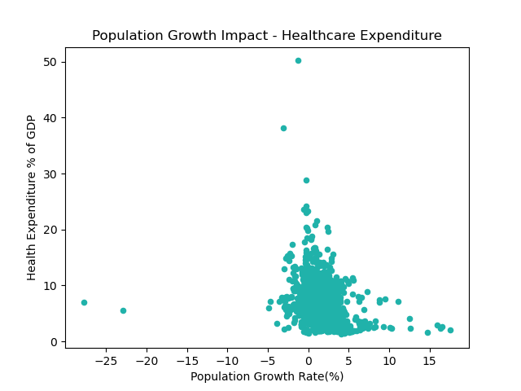
H_{o} - There is not a correlation between population growth rates and healthcare expenditure
H_{a} - There is a correlation between population growth rates and healthcare expenditure.
Data analysis - The analysis proved that the population growth rate did not make the healthcare expenditure increase.
How does the population growth rate impact the percentage expenditure on healthcare?
Notes:
How does the population growth rate impact the percentage expenditure on healthcare?
When looking at this chart we are comparing health expenditure % and population growth rate percentage. As you can see majority of countries have less than 5% population growth rate we even have some countries that have a negative population growth.
Between 1% to 3% of the population growth rate is responsible for a large percentage of total health spending. This slide shows the variation in health spending across the population through an analysis between the years of 2001 – 2020 in the W.H.O. Global Health Expenditure Database. The analysis finds that 4% of the population with the highest health expenditures accounted for nearly half of total health spending in the world.
While completing this analysis we realized that we had made error while calculating the percentage of population growth. Majority of the population growth percentage was set at 1% and it was plotting a straight line along the 1%.

Slide 9
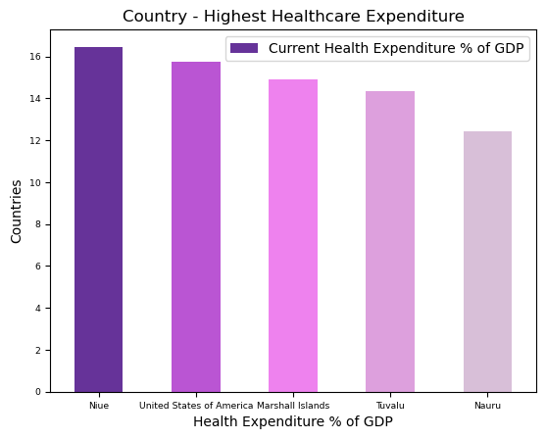
Notes:
The bar chart shows the top 5 countries with the highest percentage healthcare expenditure. These countries include: Niue, United States, Marshall Islands, Tuvalu and Nauru. The average health expenditure ranges for these countries were between 12.4% and 16.4% with an average population growth of less than 1%.

Slide 10
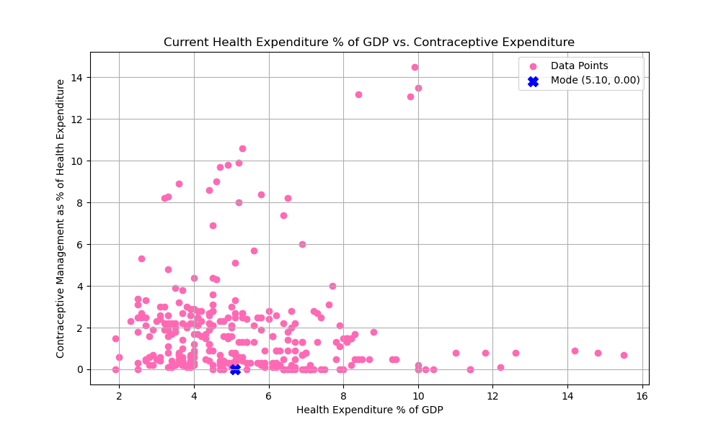
Do countries with a 10% or higher Health Expenditure of GDP also spend more towards contraceptive management?
Data analysis - Countries with higher Health Expenditure percentages do not, on average, have higher contraceptive management expenditure.
Liberia
Afghanistan
Notes:
Holding on to some of the YoY population growth Diana just mentioned - It took humanity 200,000 years to reach one billion and only 200 years to reach seven billion. Health expentiture trends can tell us how it supports (or prevents)
Overpopulation Breaking that down even more, do countries with high, in this 10% health expenditure bracket, also spend more towards contraceptive management?
As we look at our scatter plot, the X axis is showing us the % of Health Expenditure % of the country's overall GDP of course the more to the right we are, the more % of funds apply towards health expenses.They Y axis is showing: out of the Health expenditure, what % of expenses are applied to contraceptive management. The higher up the Y axis we are, the more expenses are applied to contraceptive management. Now that we understand, our chart - we can see it doesn't correlate. One of the more typical questions to as, especially as we see the countries that we see as the biggest outliers,
is does income play a role. It doesn't appear to as Liberia and Afghanistan or both classified as low income countries.

Slide 11
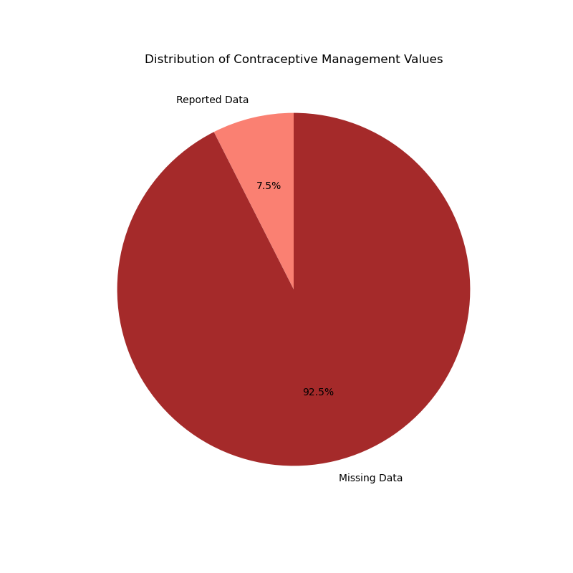
How valuable is the data?
Data analysis challenge - Of the available data points reported (4032 lines) only 7.5% had data for the contraception expenditure variable
Notes:
The data reported to W.H.O regarding healthcare expenditure and contraceptive management is extremely limited - out of 4,032 rows only 301 included the data. Making it difficult to to decide if this data

Slide 12
Does the CE impact the percentage of the GDP spent on healthcare?
H_{o}-Consumption expenditure is not correlated with the % of GDP that is spent on healthcare.
Relevant variables-
Percentage of GDP that is spent on healthcare
Consumption Expenditure Per Capita (USD)

Slide 13
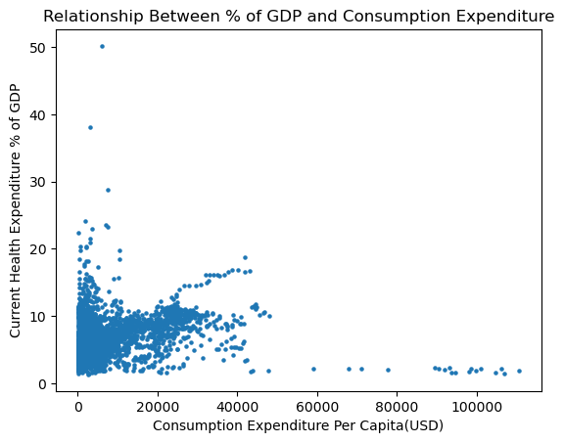
Does the CE impact the percentage of the GDP spent on healthcare?
Analysis key findings
Originally started with individual points for 192 countries over 20 years
Bucketed the data by country, taking the mean of each variable

Slide 14
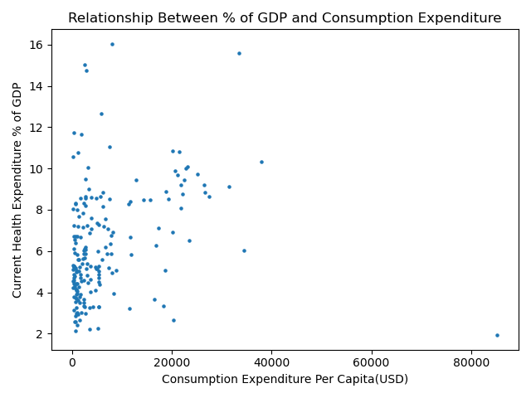
Does the CE impact the percentage of the GDP spent on healthcare?
Analysis
Pearson correlation with DF grouped by nation
p=0.0001338
We reject H_{o}
r=0.272
Weak positive correlation

Slide 15
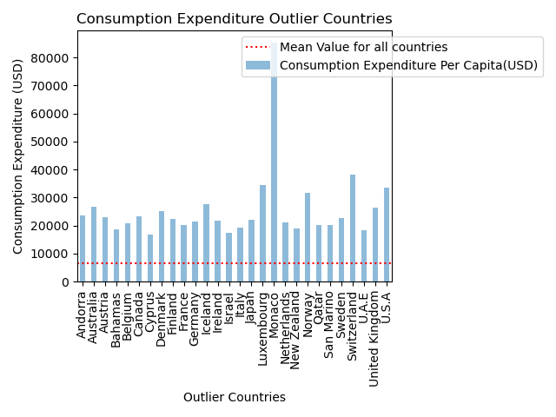
Does the CE impact the percentage of the GDP spent on healthcare?
Limitations within analysis
GHED is self reported data
Covid*
Outliers
Correlation
Grouping nations

Slide 16
Does the CE impact the percentage of the GDP spent on healthcare?
Potential implications that require further research to analyze
Types of healthcare and their cost
Life expectancy
Do “rich” countries just spend their healthcare dollars less efficiently?
mammograms
Notes:
Is there a correlation between consumption expenditure and the types of diseases countries spend their money
treating and are these more or less expensive?
Is there a correlation between consumption expenditure and life expectancy and is there a correlation between life expectancy and cost

Slide 17
Conclusion
(CE) Per Capita increased the Percentage of GDP on healthcare, potentially implying that as individuals in a country had greater capital to spend, their wellbeing, and thus the amount the nation would spend on treating illness would likely decrease. Our data proves the opposite. With a statistically significant positive correlation, it appears that as each variable increases, the other increases.
Given the positive correlation countries with lower (CE) Per Capita would likely be allocating greater percentage of their healthcare expenditure treating acute illnesses such as communicable diseases, malnutrition or injuries (which may be cheaper to treat), while countries with a higher
(CE) Per Capita would be targeting their healthcare expenditure treating non communicable diseases, such as heart disease, stroke or cancer.
We did notice the percent of health expenditure was impacted by socio economic crisis related to the pandemic and need further analysis on those implications COVID caused.

Slide 18
Summarization
Population growth impacts healthcare expenditure in complex ways.
A higher growth rate may correlate with increased spending due to larger population needs.
Countries dedicating funds to contraception often show mixed signals Further Rigorous analysis is needed to disentangle these interwoven factors.
Targeting these root determinants proves wisest for balancing human and economic welfare over the long haul.

Slide 19
—Thomas Carlyle
“He who has health has hope and he who has hope has everything ”

